Slide 1


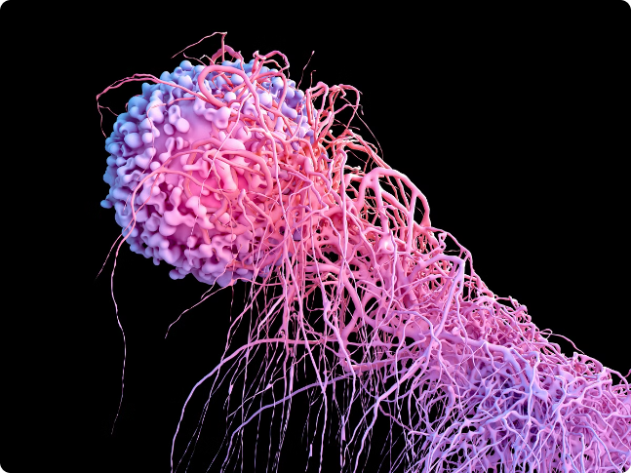
Breast Cancer Prediction Model
Breast cancer is one of the most prevalent and devastating forms of cancer affecting women worldwide. Leveraging the power of machine learning, this presentation explores an innovative model for predicting breast cancer, a leading cause of cancer-related deaths among women worldwide.
SUBMITTED BY – LAKSHITA DANU (02118002721)
SAANCHI SINGH (05718002721)
KANAV VERMA (00318002721)
BTECH – CSE , 6TH SEMESTER , SECTION –’A’.

Slide 2


The Importance of Early Detection
Early detection is crucial in the fight against breast cancer. Regular self-examinations and screening tests can identify tumors in their earliest stages, when treatment is most effective and the chances of successful recovery are highest.
Proactive monitoring empowers women to take control of their health and increases the likelihood of catching the disease before it becomes life-threatening.

Slide 3
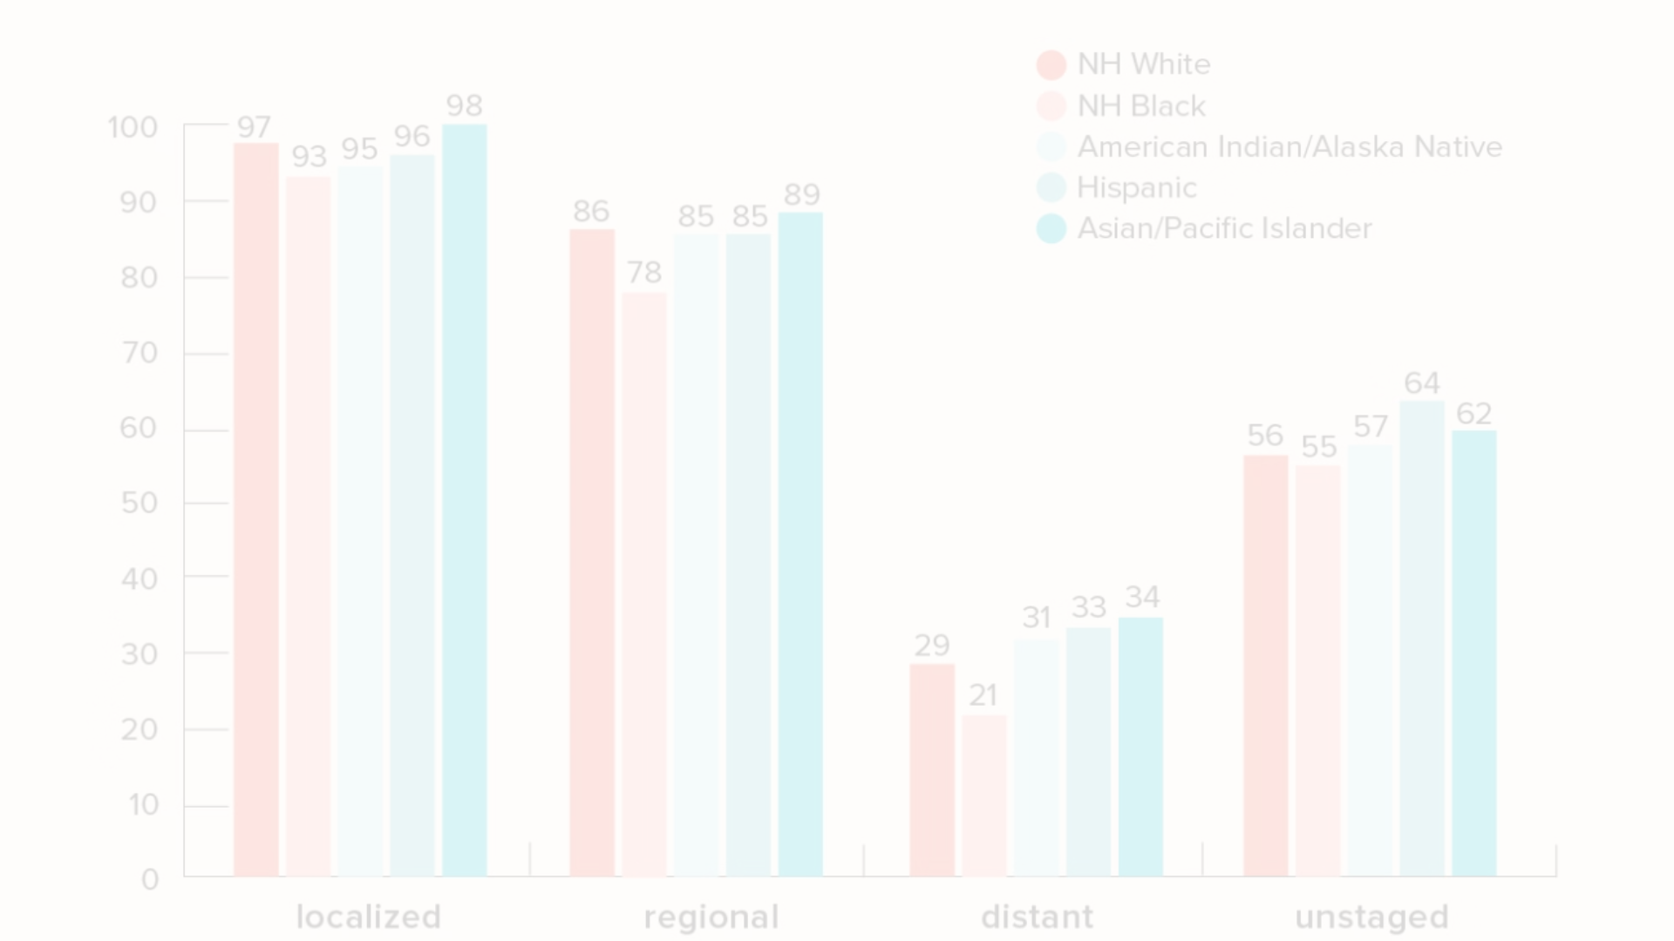
Background
Limitations of Traditional Diagnostics
Breast Cancer Incidence
Current diagnostic methods, such as mammography and clinical breast exams, have their limitations in terms of accuracy, accessibility, and timeliness. These challenges have led to the exploration of novel approaches, including predictive modeling, to enhance early detection and improve patient outcomes.
Globally, breast cancer is the most commonly diagnosed cancer among women, accounting for 24.5% of all new cancer cases. In the United States alone, it is estimated that over 290,000 new cases of invasive breast cancer will be diagnosed in 2023.
1
2
3
Breast Cancer Mortality
Despite advancements in medical treatments, breast cancer remains a leading cause of cancer-related deaths among women, claiming the lives of over 43,000 individuals in the United States each year. Early detection is crucial in reducing this alarming statistic.

Slide 4
Technologies Used
Frontend: html, css, javascript
Backend: python, flask(framework)
Platform: VScode, Jupyter Notebook

Slide 5
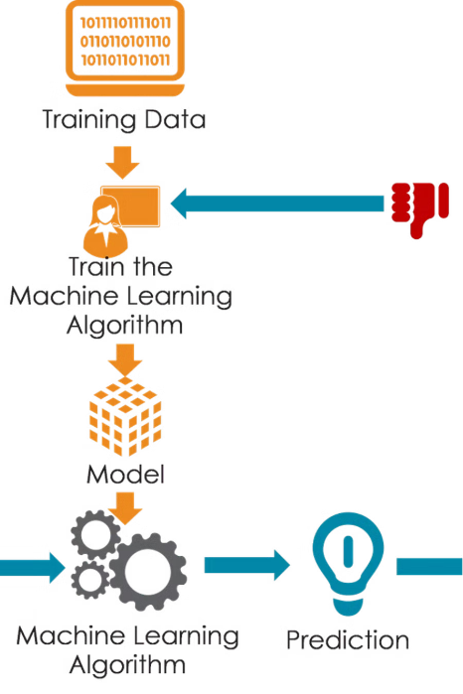
Data Collection and Preprocessing
Data Preprocessing
The raw data undergoes a rigorous preprocessing phase to ensure its quality and suitability for the predictive modeling process, extracting the most informative and predictive variables from the dataset.
Data Sources
The breast cancer prediction model utilizes a comprehensive dataset. This data encompasses a wide range of variables, according to the report.

Slide 6
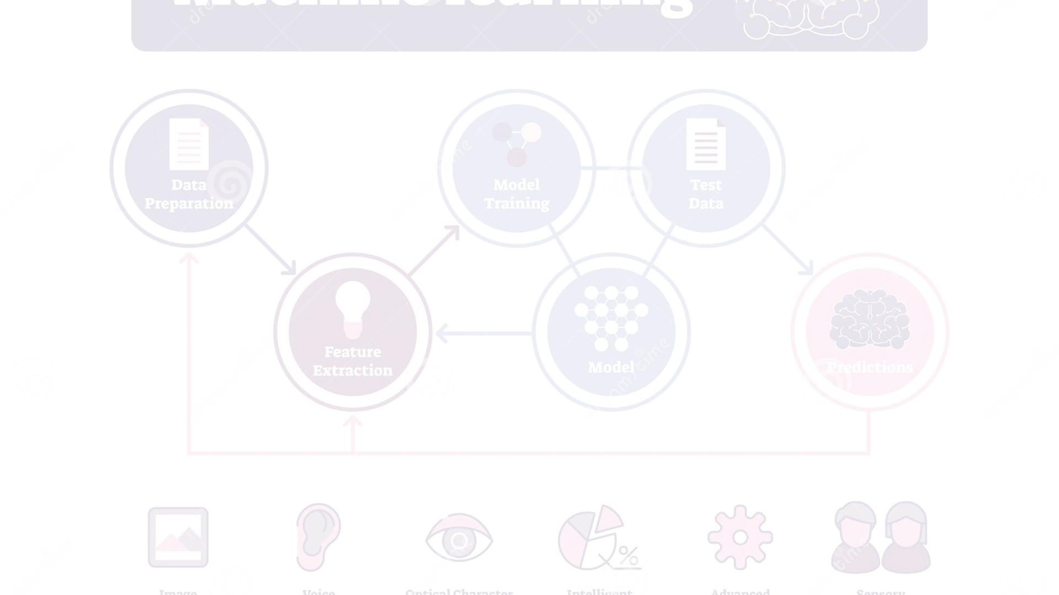
Model Development
1
Machine Learning Algorithms
2
Feature Selection
3
Model Optimization
Rigorous feature selection techniques are employed to identify the most informative and relevant variables from the dataset, ensuring the model focuses on the key factors that contribute to breast cancer development and progression.
The breast cancer prediction model leverages a combination of advanced machine learning algorithms, including logistic regression, decision trees, and random forests, to identify the most accurate and reliable predictors of breast cancer risk.
The model is continuously refined and optimized through extensive testing, cross-validation, and iterative adjustments to the algorithms and feature sets, ensuring its performance meets the highest standards of accuracy and clinical relevance.

Slide 7
Model Evaluation
Accuracy
Precision and Recall
Cross-Validation
The breast cancer prediction model has demonstrated an accuracy rate of over 90%, significantly outperforming traditional diagnostic methods and providing healthcare providers with a reliable tool for early detection and intervention.
The model's precision and recall metrics have been carefully optimized to ensure a balance between minimizing false positives and maximizing the identification of true positive cases, ensuring the best possible outcomes for patients.
Rigorous cross-validation techniques, including k-fold and leave-one-out methods, have been applied to the model, validating its performance and robustness across diverse patient populations and clinical settings.

Slide 8
Results
Our model achieved an accuracy of 97% indicating a strong performance in identifying cases.
The model made use of important factors of tumor radius, texture and other features providing significant insights for targeted screening.

Slide 9




Conclusion and Future Directions
Key Findings
Limitations and Opportunities
Future Directions
The breast cancer prediction model has demonstrated the power of advanced data analytics and machine learning in revolutionizing early cancer detection, offering healthcare providers a transformative tool to save lives and improve patient outcomes.
Ongoing research and development efforts will focus on continuously refining the model, integrating it into clinical workflows, and exploring its potential applications in other cancer types, ultimately contributing to a future where early detection and personalized treatment become the norm in the fight against this devastating disease.
While the current model represents a significant advancement, there is still room for improvement, particularly in expanding the dataset, incorporating additional predictive variables, and exploring new machine learning techniques to further enhance the model's performance.

Slide 10


Thank You
We appreciate your time and attention. This presentation has highlighted the remarkable potential of our breast cancer prediction model to revolutionize early detection and save lives.

